Slide 1
General AE/ENVE/GEOE 121 Help Session
Run by: Seth Bailey

Slide 2
Table of Contents
Order of Operations
Creating and Indexing Matrices
‘if ‘ Statements
‘for’ Loops
When to use the ‘break’ function
‘while’ Loops

Slide 3
Order of Operations
Parentheses () Highest order
Transpose, power ‘ ^
Negation ~
Multiplication, division * /
Addition, subtraction + -
Relational operations < > <= >= == ~=
And, or && || Lowest order

Slide 4
Order of Operation Examples
log1 = 5 + 7 >= 3 * 5
log2 = 7 * (2 < 4 – 2)
log3 = (7^2 + 1 == 50) && ~(5 * 2 – 10)
log4 = log 1 - 5 || ~log3

Slide 5
Creating and Indexing Matrices
Methods to create a matrix:
zeros(n, m) or zeros(n)
ones(n, m) or ones(n)
‘step’ functions:
1:n or 1:step:n
Generally: start:step:final
Methods to index a matrix (mat):
Linear index – mat(n)
Subscript index – mat(n, m)
All rows/columns – mat(:, m) or mat(n, :)
Subset of matrix – mat(start:end, m) or mat(n, start:end)

Slide 6
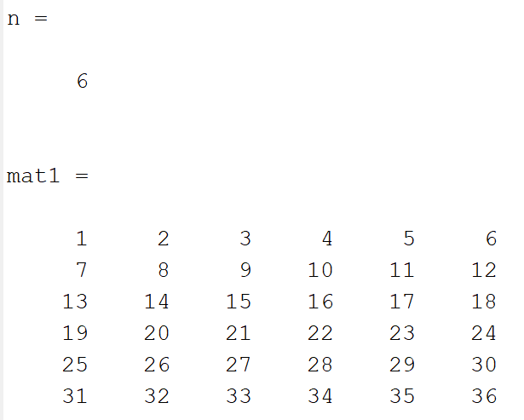
Creating and Indexing Examples
mat1(7) =
mat1(4, 4) =
mat1(:, 2) =
mat1(1:n/2, 1:n/2) =
mat1(2, end) =
mat1(1:n/2, end:-1:n/2+1) =
Notes:
6x6 matrix of increasing order [1 2 3 4 5 6; 7 … 36], call it mat1

Slide 7
‘if’ Statements
Purpose:
Use logical statement to enter a set of actions, with alternative options available
Format:
if (logical statement)
action1
elseif (logical statement)
action2
else
action3
end

Slide 8
‘if’ Statement Example
num1 = 5; Output:
num2 = 10;
same = false;
if num1 == num2
same = true
elseif num2 > num1
num2greater = true
num1greater = false
else
num2greater = false
num1greater = true
end

Slide 9
‘for’ Loops
Purpose:
Run through an action or a set of actions a defined number of times
Format:
for (variable = start:end)
action1;
action2;
end

Slide 10
‘for’ Loop Example
mat = [1 2 3; 4 5 6; 7 8 9];
sumr = 0;
for ii = 1:numel(mat)
sumr = sumr + mat(ii);
end
OR
[nr, nc] = size(mat)
for ii = 1:nr
for jj = 1:nc
sumr = sumr + mat(ii,jj);
end
end
Notes:
Answer is 45

Slide 11
When to use ‘break’
When you want to exit a ‘for’ or ‘while’ loop (can only use ‘break’ inside a loop)
Example - checking if a sequence is in order:
asc_order = true;
vec = [1 2 3 4 5];
for ii = 1:(5-1)
if vec(ii) >= vec(ii + 1)
asc_order = false;
break;
end
end

Slide 12
‘while’ Loops
Purpose:
Run through an action or a set of actions until a condition is no longer met
Format:
while logical statement (that will update as the loop runs)
action1;
action2;
end
Useful when “filling” a vector/matrix until a threshold is reached

Slide 13
‘while’ Loops Example
loc_vec = zeros(1, 5);
mat = [1 2 3 4; 5 6 7 8; 9 10 11 12];
counter = 1;
ii = 0;
while counter < 6
ii = ii + 1;
if rem(mat(ii), 2) == 0
loc_vec(counter) = ii;
counter = counter + 1;
end
end

